Slide 1
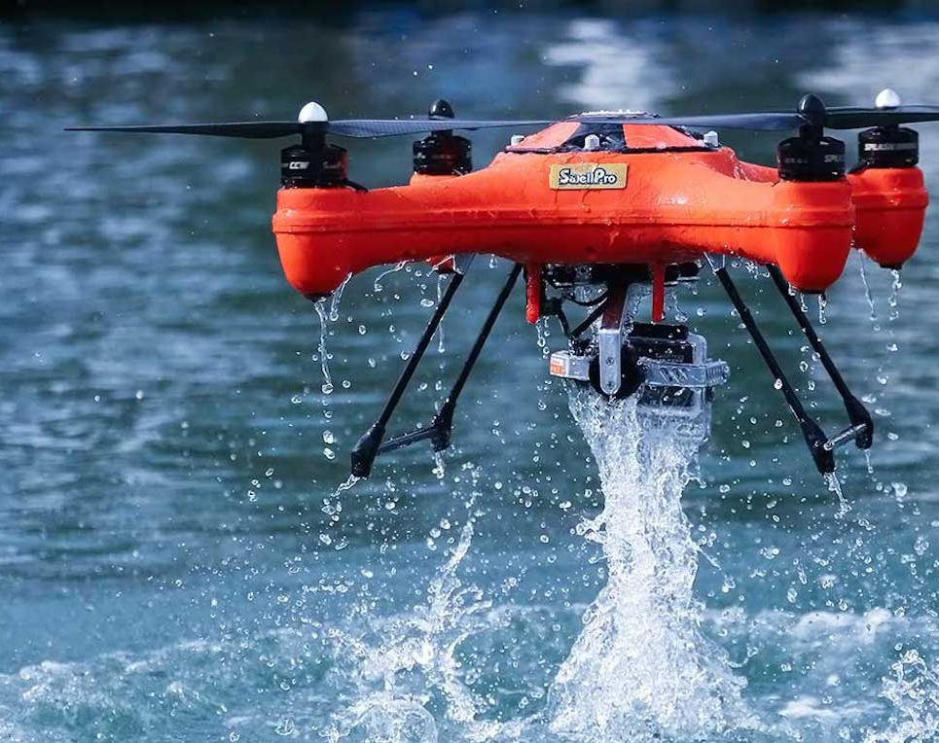
H20ptimism: Advancing Innovations in Water and Sanitation

Slide 2
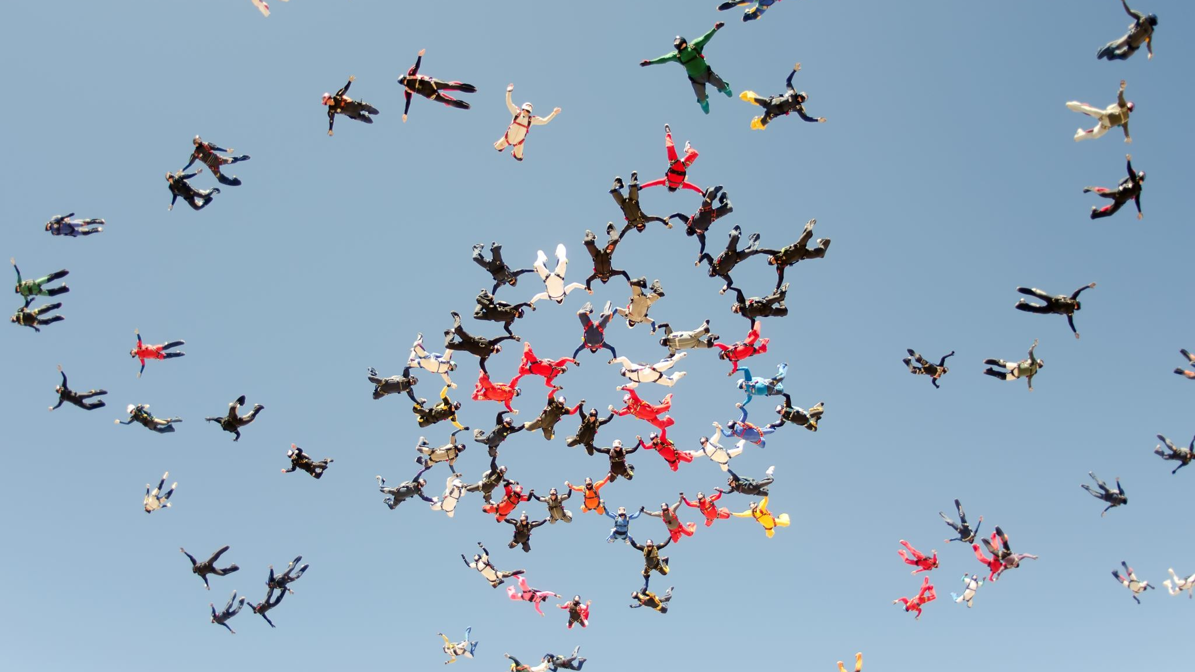
Let’s Change The World
Ladies and Gentlemen,
A warm welcome from the visionary minds at H20ptimism! We are a dynamic team of accomplished African American marine research biologists with an ambitious mission – to redefine the landscape of global access to pristine and rejuvenating water. Let's take a moment to applaud the brilliant individuals shaping the future of H20ptimism:
- Neresha Miller
- Rayshon Lawrence
- Xavier Kelly
- Emir Kendrick
- Mac-Anthony Ike
Get ready to be captivated as we navigate through innovative solutions aimed at transforming the critical issue of water accessibility on a global scale. Join us on this thrilling journey toward a brighter, water-abundant future.

Slide 3
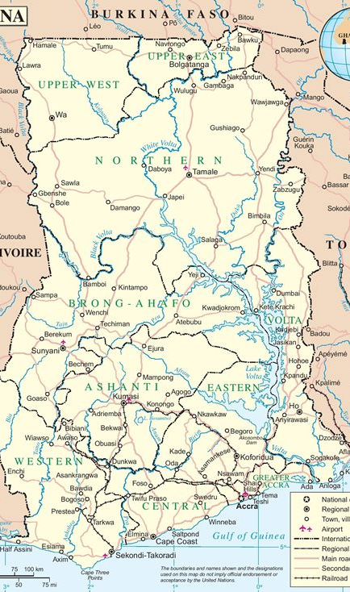
Mission Statement
H2Optimism is dedicated to harnessing state-of-the-art technology, incorporating drones, sensors, and mobile applications, to methodically monitor and effectively deliver clean water to households and individuals throughout Ghana.

Slide 4
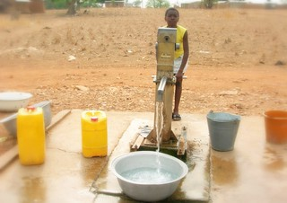
Target Audience
Citizens of Ghana (34 million) and the Global Population,
Initially, we’re only operating within the country of Ghana with intentions to expand outwards to other surrounding countries and continents. Embracing this technology can revolutionize water management.
This Photo by Unknown author is licensed under CC BY-NC-ND.

Slide 5

Problem Statement
In Ghana, approximately 3.9 million people face the critical challenge of lacking access to clean water. This pervasive issue not only jeopardizes their daily well-being but also poses a significant risk of widespread illnesses and diseases. The reliance on the Volta River as the primary water source further underscores the urgency of addressing this crisis, emphasizing the need for sustainable solutions to ensure a safe and reliable water supply for the affected population.
Illnesses and Diseases: Diarrheal disease, Typhoid and Dysentery

Slide 6
SetBacks | Roadblocks
The life of the drone battery, charging the drone battery consisted of major setbacks and cost concerns.
The distance in which the drones can operate are restricted by the power and size of the battery.
Weather related issues delaying the delivery & pickup of water sources.

Slide 7
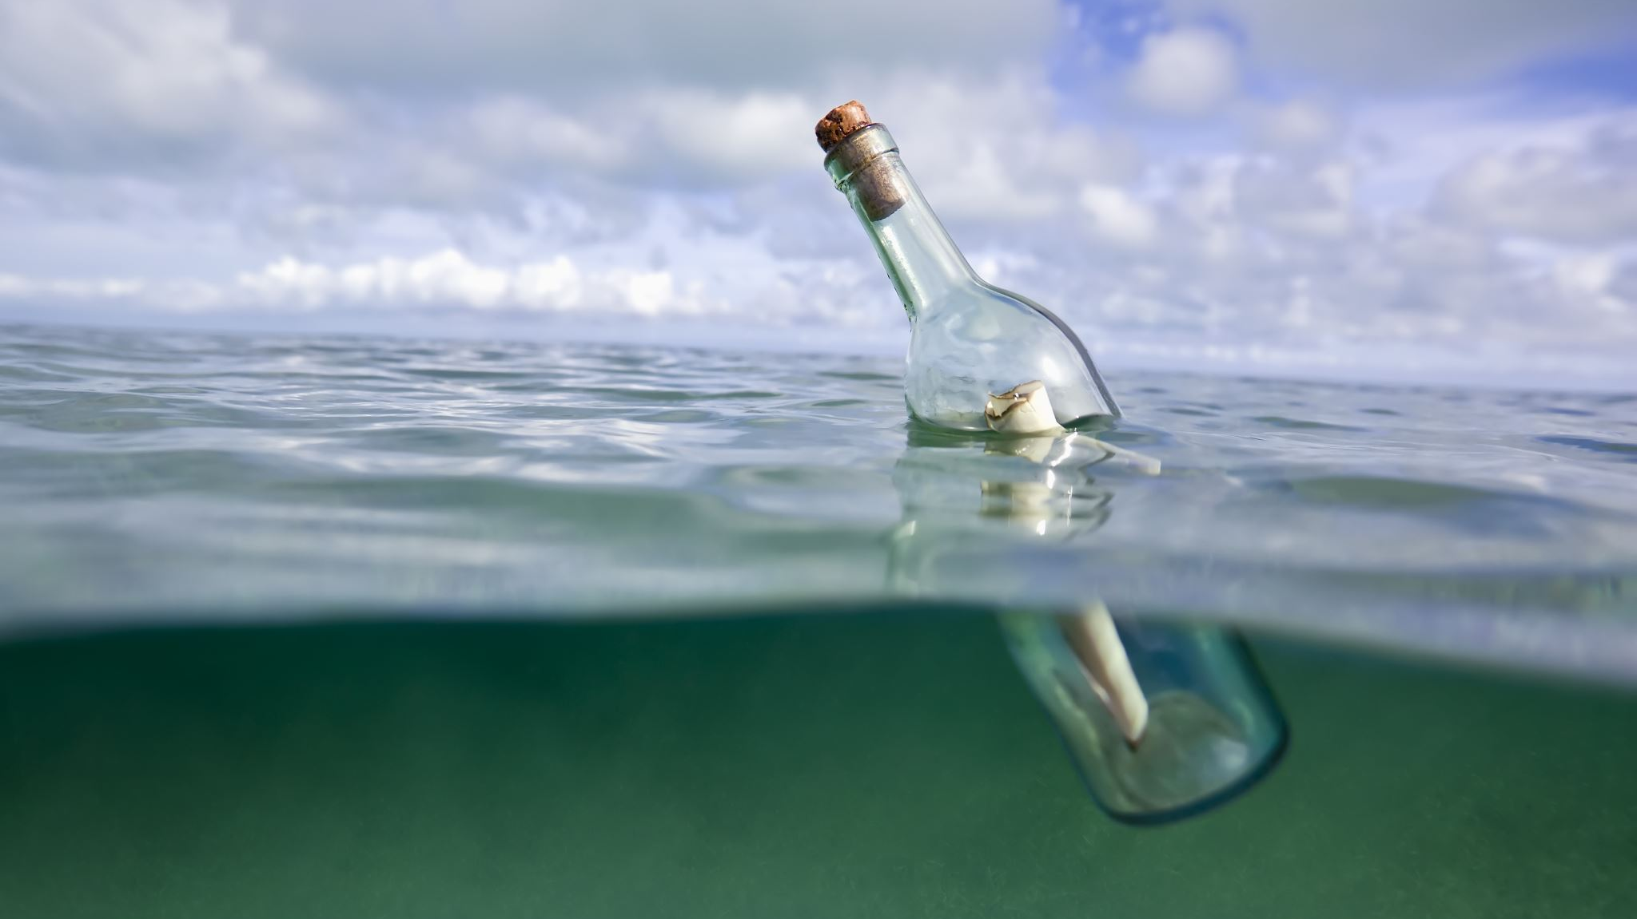
Problem & Solution
Limited Payload Capacity:
Problem: Drones may have limited payload capacities, restricting the amount of water they can collect in a single trip.
-Solution: Invest in advanced drone technology with higher payload capacities or explore swarm technology where multiple drones collaborate to collect larger volumes collectively.
Energy Constraints:
- Problem: Drones are often limited by battery life, which may constrain the distance they can cover or the time they can spend collecting water.
- Solution: Develop more energy-efficient drone systems, explore solar-powered options, or establish efficient charging stations strategically placed in the collection areas.
Navigation Challenges:
- Problem: Navigating through complex terrains or densely populated areas can be challenging for drones, leading to potential collisions or inefficiencies.
- Solution: Implement advanced obstacle avoidance systems, utilize GPS technology, and incorporate machine learning algorithms for adaptive navigation in diverse environments.

Slide 8
Problem & Solution
Community Acceptance:
Problem: Communities might be hesitant to accept drone technology for water collection due to unfamiliarity or concerns about reliability.
Solution: Conduct community engagement programs to educate and involve residents in the technology adoption process. Demonstrate the benefits and reliability of drone-assisted water collection through pilot programs.
Regulatory Compliance:
Problem: Strict aviation regulations may hinder the deployment of water-collecting drones in certain regions.
Solution: Collaborate with regulatory authorities to establish guidelines for safe drone operations. Advocate for updated regulations that accommodate and support the use of drones for humanitarian and environmental purposes.

Slide 9
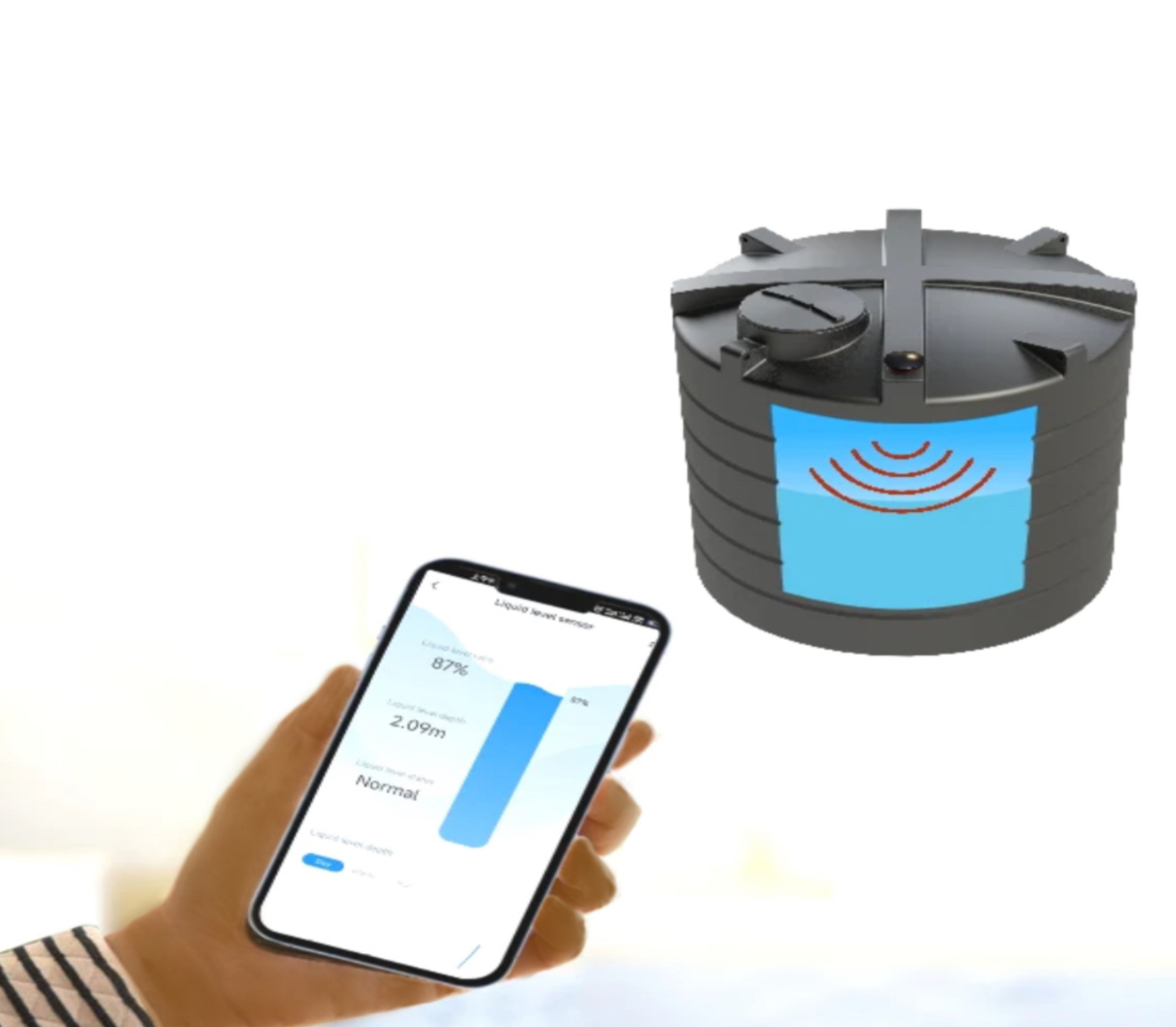
Solution
HydroScape will collect and transport water containers from a self-cleaning water containment system, utilizing a filtration mechanism to purify the Volta River. As the drone hovers and filters the water, it will journey to various villages involved in the initiative, delivering the water to designated storage units. These storage units are equipped with sensors that communicate the water requirements to the drone.

Slide 10
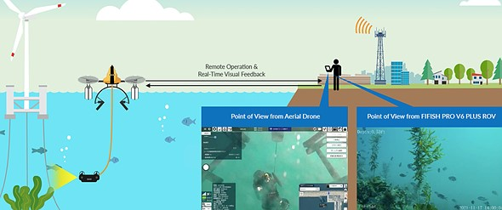
Point of View from HydroScape
Point of View from (W.I.D) Water Intake Device

Slide 11
How is Tech Used?
Electric Drone
Cellular Devices
Censored Container(s)
Cell Tower
Solar Panels

Slide 12
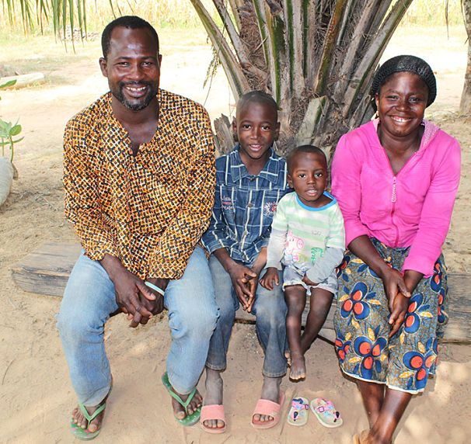
USE CASE
Abina, Kojo, Adzo, and Asante, a Ghanaian family of four, were among the millions in Africa facing the challenge of inadequate access to clean water sources. Recognizing their hardship, H20ptism extended its services to the family for free. The company installed a cellar device at their residence and integrated phone alert systems to signal company employees for timely water drone deployment, ensuring the family's water tank was consistently replenished.

Slide 13

Potential Costs
Each Hydro2O costs about $10k each to build
Water towers for large scale containment are $10k each
Water tanks for individual homes costs $2k each
With about 3.4 million homes that can cost up to $6.8 billion
Cell towers to communicate with the drone's cost $300k each
Industrial solar panel systems of this scale with need about $2 million

Slide 14

Reference(s)
Amankwaa, Godfred. “Water ATMs Were Introduced in Ghana, Changing the Way People Access This Vital Resource.” Phys.Org - News and Articles on Science and Technology, Phys.org, 2 Feb. 2023, https://phys.org/news/2023-02-atms-ghana-people-access-vital.html.
Edwards, Brian. “The Effects of Drinking Dirty and/or Contaminated Water.” Hague Quality Water of Maryland, https://www.facebook.com/HagueofMaryland, 8 July 2016, https://haguewaterofmd.com/effects-drinking-dirty-andor-contaminated-water/#:~:text=Some%20of%20the%20more%20commonly%20reported%20problems%20experienced,Stomach%20Aches%
Ryan. “What Is an Industrial Water Treatment System and How Does It Work? - SAMCO Technologies.” SAMCO Technologies, 29 Sept. 2017, https://samcotech.com/what-is-an-industrial-water-treatment-system-process/.
Murphy, Kara. “Introducing the First Drone That Works Both in the Air and Underwater: Digital Photography Review.” DPReview, DPReview, 20 Jan. 2022, https://www.dpreview.com/news/7663525278/introducing-the-first-drone-that-works-both-in-the-air-and-underwater.
“What Is a Reverse Osmosis System and How Does It Work? – Fresh Water Systems.” Fresh Water Systems, https://www.freshwatersystems.com/blogs/blog/what-is-reverse-osmosis. Accessed 27 Feb. 2024.
Ghana population 1950-2024. MacroTrends. (n.d.). https://www.macrotrends.net/globalmetrics/countries/GHA/ghana/population#:~:text=The%20current%20population%20of%20Ghana,a%202.03%25%20increase%20from%202020.

